Slide 1
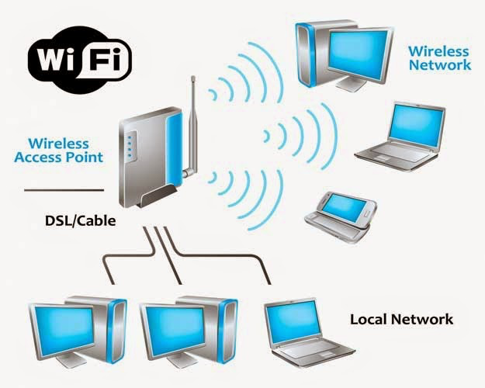
What is Wi-Fi?
Short for wireless fidelity.
It is a wireless technology that uses radio frequency to transmit data through the air.
A wireless local area network (WLAN) is a wireless computer network that links two or more devices using a wireless distribution method

Slide 2
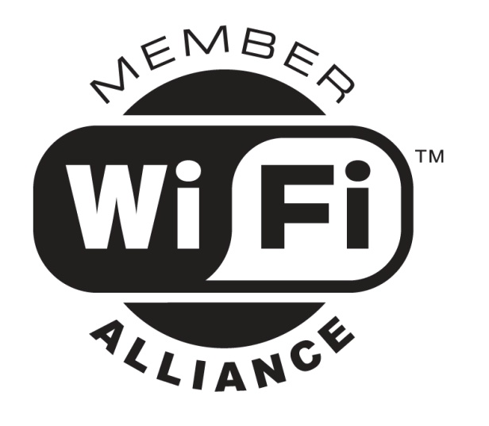

Wi-Fi Alliance
Non-profit standards organization.
Global organization that created the Wi-Fi brand name.
Formerly the Wireless Ethernet Compatibility Alliance.
The Wi-Fi CERTIFIED logo from the Wi-Fi Alliance.
Rigorous interoperability testing requirements.Certifies the interoperability of 802.11 products from the many different vendors.

Slide 3
802.11 Operating Frequency
The 802.11 suite has been developed to enable wireless local area networking in either the 2.4 GHz or 5.2 GHz frequency bands.
Specifically, the frequencies used by 802.11 fall in the unlicensed bands, these are frequency bands which anyone can use for radio communication (without a license) as long as their radio waves do not radiate too much power.
The exact frequencies used (and how they are used) depends on whether the system follows 802.11b, 802.11a, or 802.11g.

Slide 4
Standards Comparison
802.11 network PHY standards | Release Date | Frequency (GHz) | Bandwidth (MHz) | Stream Data Rate (Mbit/s)
802.11 legacy | Jun 1997 | 2.4 | 22 | 1, 2
a | Sep 1999 | 5 | 20 | 6, 9, 12, 18, 24, 36, 48, 54
 |  | 3.7[A]
b | Sep 1999 | 2.4 | 22 | 1, 2, 5.5, 11
g | Jun 2003 | 2.4 | 20 | 6, 9, 12, 18, 24, 36, 48, 54
n | Oct 2009 | 2.4/5 | 20 | 400 ns GI : 7.2, 14.4, 21.7, 28.9, 43.3, 57.8, 65, 72.2 800 ns GI : 6.5, 13, 19.5, 26, 39, 52, 58.5, 65
 |  |  | 40 | 400 ns GI : 15, 30, 45, 60, 90, 120, 135, 150 800 ns GI : 13.5, 27, 40.5, 54, 81, 108, 121.5, 135

Slide 5





WLAN Architecture—Ad Hoc Mode
Ad-Hoc mode: Peer-to-peer setup where clients can connect to each other directly. Generally not used for business networks.

Slide 6
Ad Hoc Structure
Mobile stations communicate to each other directly.
It’s set up for a special purpose and for a short period of time. For example, the participants of a meeting in a conference room may create an ad hoc network at the beginning of the meeting and dissolve it when the meeting ends.

Slide 7

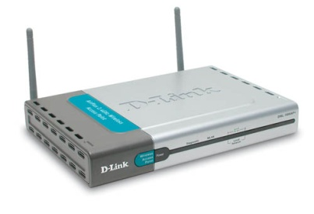
WLAN Architecture—Infrastructure Mode
To Wired Network

Slide 8
Infrastructure network
There is an Access Point (AP), which becomes the hub of a “star topology.”
Any communication has to go through AP. If a Mobile Station (MS), like a computer, a PDA, or a phone, wants to communicate with another MS, it needs to send the information to AP first, then AP sends it to the destination MS
Multiple APs can be connected together and handle a large number of clients.
Used by the majority of WLANs in homes and businesses.

Slide 9
Comparison of Two Structures
    Infrastructure Ad hoc
Expansion X
Flexibility X
Control X
Routing X
Coverage X
Reliability X

Slide 10
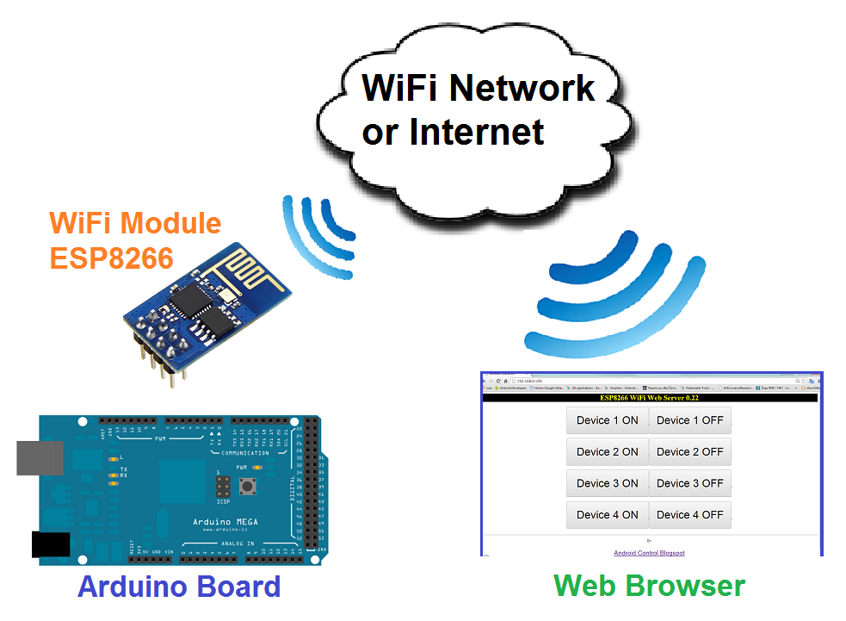
Working with Wi-Fi module(ESP8266)

Slide 11
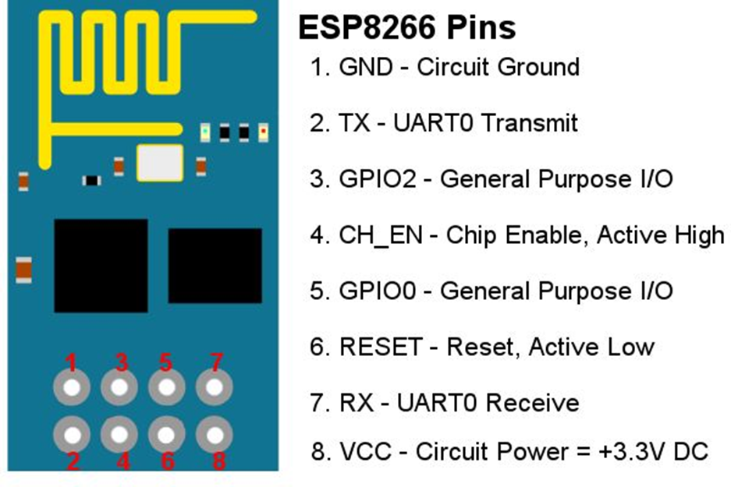
Working with Wi-Fi module(ESP8266)
UNO --- ESP8266
RX(2) ----- RX
TX(3) ----- TX
GND --- GND
3.3V --- VCC
3.3V --- CH_PD
Set serial monitor for "Both NL & CR" and Baud to 9600

Slide 12
Configure as access point(1):
1. AT+CWMODE=2
Configure as AP
2. AT+CWSAP="ESP8266","123",3,0
Set SSID, password, channel and encryption.
To allow connections without a password set encryption parameter to 0 which is OPEN mode. To allow only users with a valid password, set encryption to 1, 2, 3 or 4. These encryption modes correspond to WEP, WPA-PSK, WPA2-PSK and WPA/WPA2-PSK with WPA2-PSK being the most secure and common for general use.
AT+CWSAP?
Verify that the AP settings have been set correctly.

Slide 13
Configure as access point(2):
3. AT+CIPMUX=1
Mode of TCP connection(single/multiple)
Single connection mode is set with a 0 value while multiple connection mode is set with a value of 1. This mode can only be changed after all connections are disconnected. If server is started, reboot is required.
2. AT+CIPSERVER=1
Configure TCP Server.
A value of 1 creates the the server while 0 deletes the server in which case the module needs to restarted. The port can be optionally specified as a second argument otherwise it the default port of 333 is used.

Slide 14
Configure as Station(1):
1. AT+CWMODE=2
Configure as Station
2. AT+CWJAP="SSID","PASS“
Connect to AP.
Command takes 2 arguments, SSID which is the name of the network and the PASSwhich is the password of the same network.

Slide 15
Configure as Station(2):
3. AT+CIPMUX=0
Mode of TCP connection(single/multiple)
2. AT+CIPSTART="TCP","192.168.0.65","333"
Start TCP or UDP connection in single connection mode.
The connection type can be either TCP or UDP. 192.168.0.65 is the IP address of the remove server the connection is being made to. 333 is the port of the same remote server.
AT+CIPSTART=1,"TCP","192.168.0.65","333“
(Multiple Connection mode) where first argument is the id of the connection

Slide 16
Sending Data
3. Send data in single connection mode.
AT+CIPSEND=15
When in single connection mode only the length of the data in bytes is required. Maximum length is 2048 bytes. Send command should be immediately followed by the actual data that matches the length specified.

